Slide 1
Integrate LangFuse to AI Agent
Sankareswari Athiappan
8 Jul 2025
Notes:
28

Slide 2

Integrate LangFuse to AI Agent
Git URL for Python File: https://github.com/Sankari-KK/new-learning/blob/a220d85c6a7fff1c711a3dac28f00cc2f388ada7/Langfuseworking.ipynb
Trace JSON File: https://github.com/Sankari-KK/new-learning/blob/a220d85c6a7fff1c711a3dac28f00cc2f388ada7/Langfuse_trace-aaa1b1e10c4f5ad07f62305456974edd.json
Langfuse Tracing Screenshots provided in the next slide

Slide 3
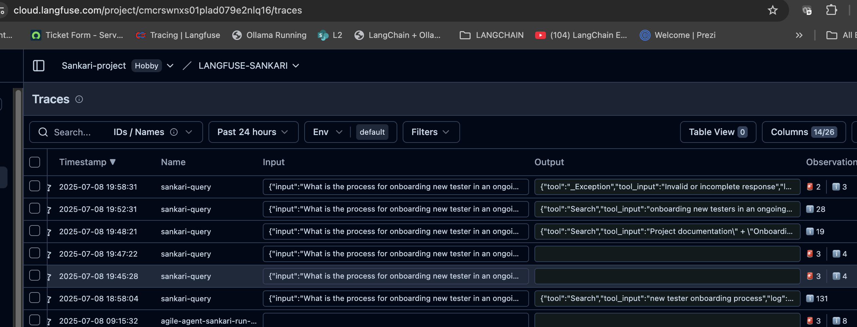
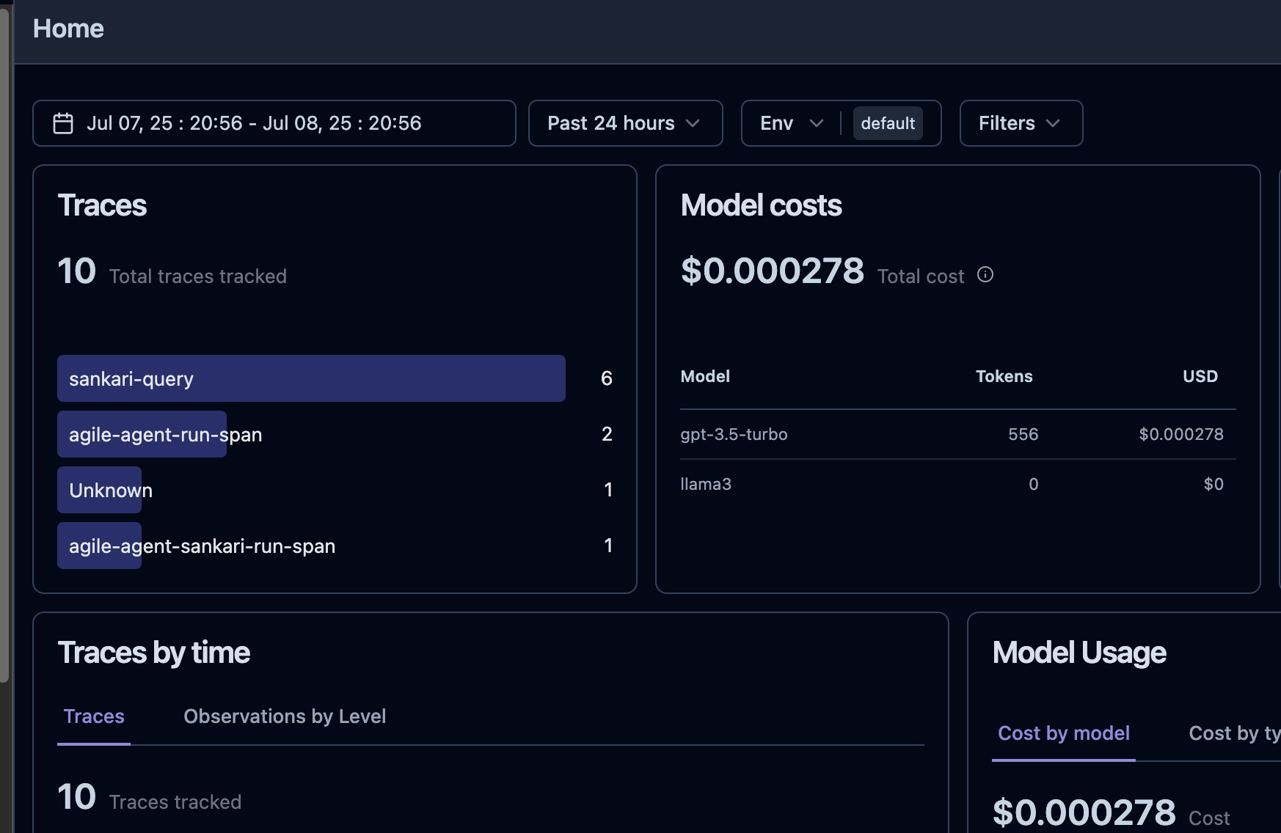
LangFuse Screenshots

Slide 4
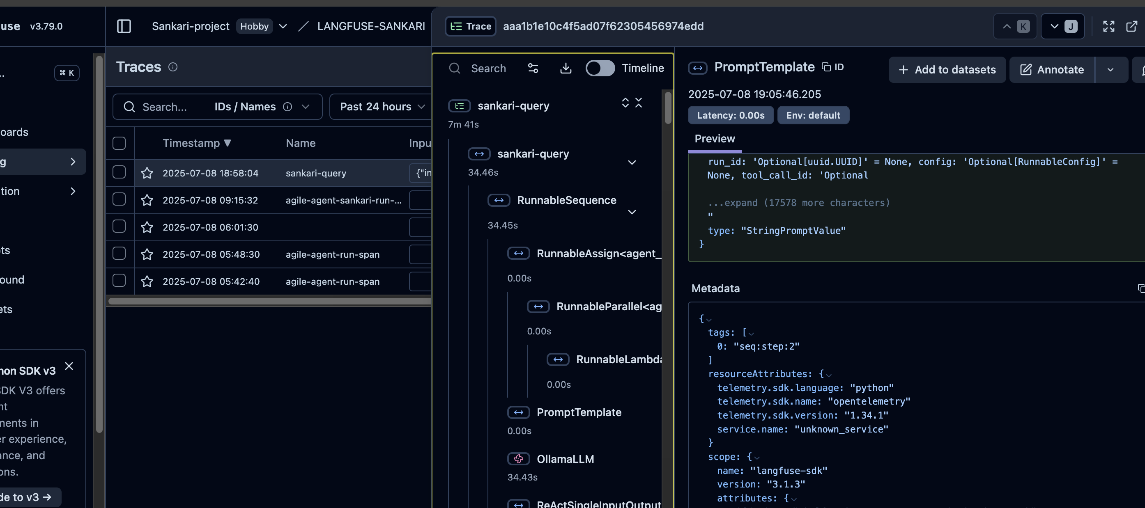
LangFuse Screenshots

